Slide 1
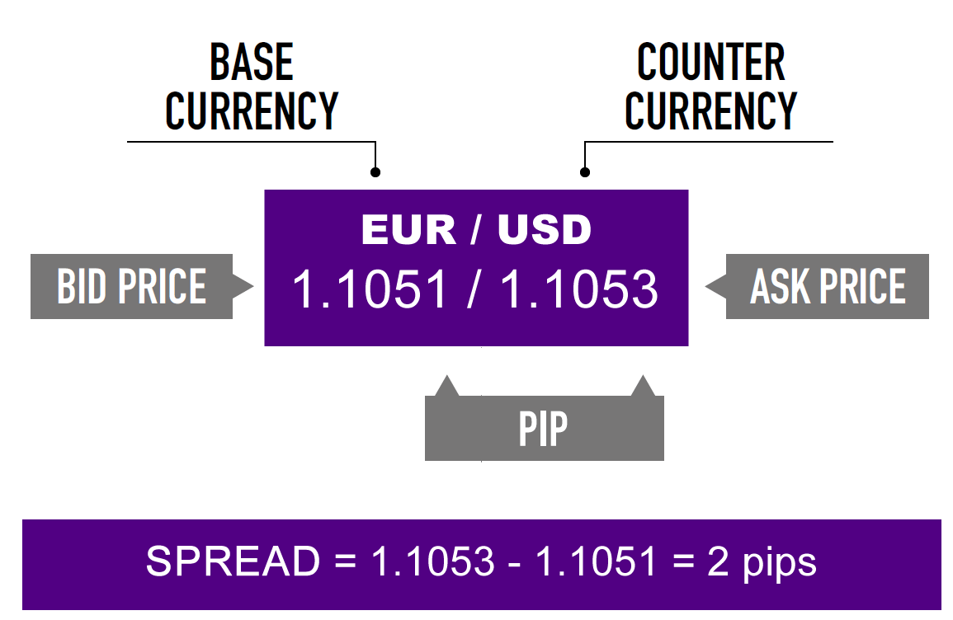
Spread

Slide 2
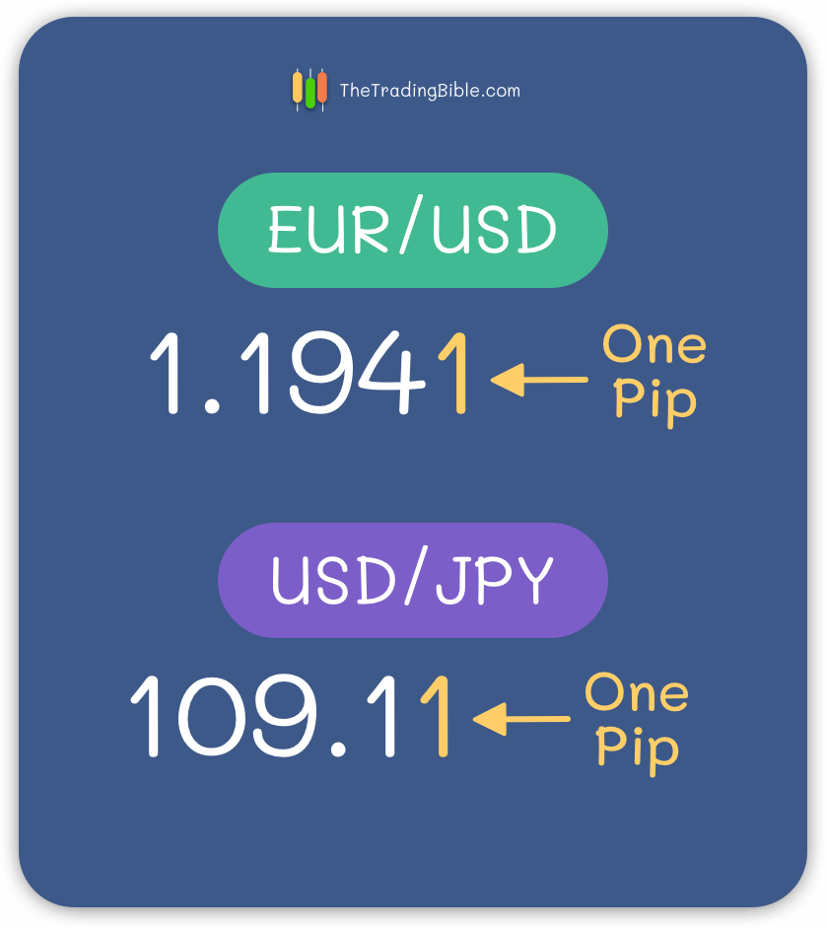
Lots Pips Margin and Leverage in Forex
Pip - A pip is the smallest whole unit price move that an exchange rate can make, based on forex market convention. Most currency pairs are priced out to four decimal places and a single pip is in the last (fourth) decimal place. ( JPY pairs are priced out to 2 decimal places and single pip is in the 2nd decimal place.

Slide 3
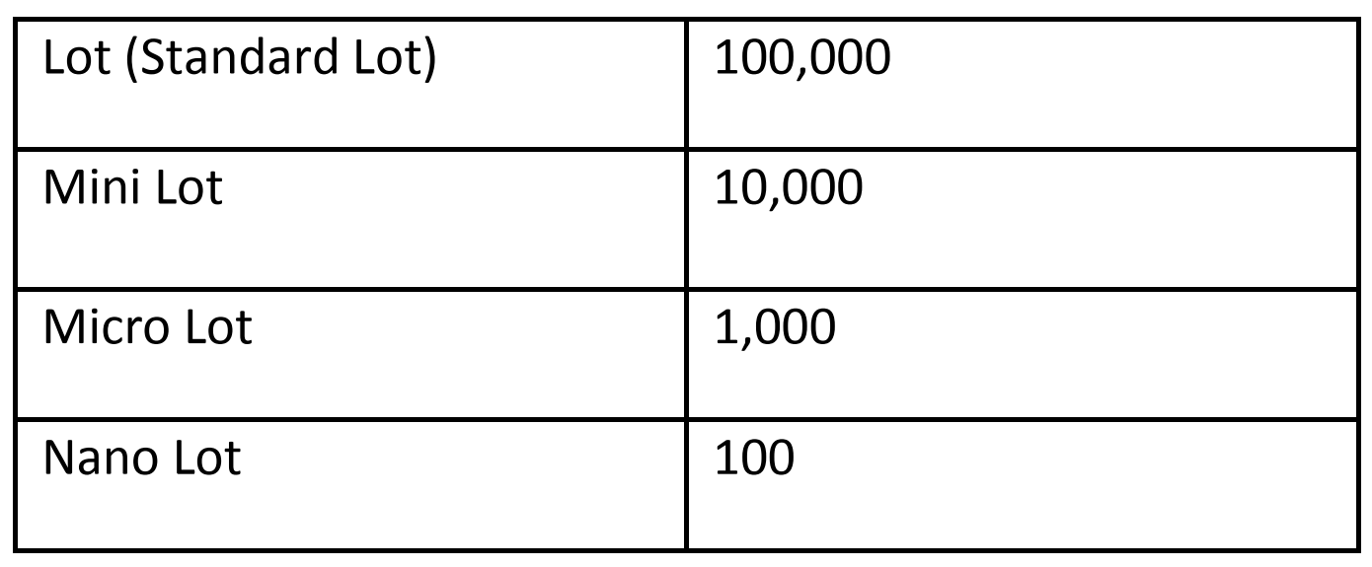
Lot is a 100,00 units
EUR 1 lot = 100,000 EUR
GBP 1 lot = 100,000 GBP
Margin – Amount of money needed to open a position
Leverage - a way for traders to borrow capital to gain a larger exposure to the FX market. With a limited amount of capital, they can control a larger trade size.

Slide 4
Eg -
Calculate margin for 0.01 lots of EUR/USD buy order (bid = 1.0618 , ask = 1.0628 )
EUR/USD = 1.0628
EUR 1 lot = 106 280 USD
EUR 0.01 lot = 106 2.80 USD
Leverage = 100x
1062.80 / 100 = 10.6280 USD
Now value of EUR/USD is (bid = 1.0718 , ask = 1.0725) now calculate the profit
Current Value of EUR 1 lot = 107 180 USD
Previous value of EUR 1 lot = 106 280 USD
Profit for 1 lot = (107 180 – 106 280) USD
= 900 USD
Profit for 0.01 lot = 9 USD
Now value of EUR/USD is (bid = 1.0518 , ask = 1.0525) now calculate the loss
Current Value of EUR 1 lot = 105 180 USD
Previous value of EUR 1 lot = 106 280 USD
Profit for 1 lot = (105 180 – 106 280) USD
= -1100 USD
Profit for 0.01 lot = -11 USD

Slide 5
Eg -
Calculate margin for 0.01 lots of USD/JPY buy order (bid = 131.87 , ask = 131.97)
USD 1 lot = 100 000 USD
USD 0.01 lot = 1000 USD
Leverage = 100x
1000 / 100 = 10 USD
Now value of USD/JPY is (bid = 132.87 , ask = 132.97) now calculate the profit
Current Value of 1 lot of USD = 13 287 000 JPY
Previous value of 1 lot of USD = 13 197 000 JPY
Profit for 1 lot = (13287000 – 13197000) JPY
= 90000 JPY
Profit in USD = 90000/ 132.97 USD
= 676.84 USD
Profit for 0.01 lot = 6.76 USD
Now value of USD/JPY is (bid = 130.87 , ask = 130.97) now calculate the loss
Current Value of 1 lot of USD = 13 087 000 JPY
Previous value of 1 lot of USD = 13 197 000 JPY
Profit for 1 lot = (13087000 – 13197000) JPY
= -110 000 JPY
Profit in USD = -110 000/ 130.97 USD
= -839.88 USD
Profit for 0.01 lot = -8.39 USD

Slide 6
Eg -
Calculate Profit for I pip of EUR/USD 1lot
Lets imagine starting price EUR/USD = 1.2345
Lets imagine end price EUR/USD = 1.2346
Current Value of EUR 1 lot = 123 460 USD
Previous value of EUR 1 lot = 123 450 USD
Profit for 1 lot = (123 460 – 123 450) USD
= 10 USD
Profit for 0.1 lot = 1 USD
Profit for 0.01 lot = 0.1 USD

